Slide 1
Triangle Multiple
Based on
Fraction of a Triangle (?)
Forty Harder Problems p5

Slide 2




Triangle Multiple
(Not to scale)
$$4$$
$$3$$
$$8$$
$$4$$
In terms of area, what multiple of the smaller triangle is the larger triangle?

Slide 3
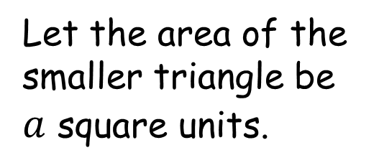

Triangle Multiple
$$4$$
Let the area of the smaller triangle be $a$ square units.
$$3$$
$$a$$
$$8$$
$$4$$

Slide 4
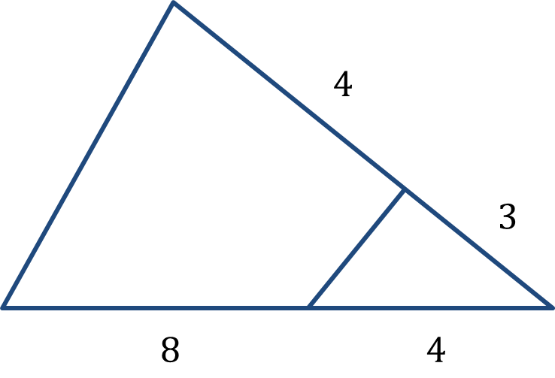

Triangle Multiple
Both triangles with their base lengths marked have the same altitude (perpendicular height) so their areas are in the same ratio as their base lengths.
$$4$$
$$\frac{4}{3}a$$
$$3$$
$$a$$

Slide 5


Triangle Multiple
We can apply the same logic again.
$$\frac{8}{4}\left(\frac{7}{3}\right)a$$
$$\frac{7}{3}a$$
$$8$$
$$4$$

Slide 6

Triangle Multiple
Summarising, we have:
$$\frac{4}{3}a$$
$$\frac{14}{3}a$$
$$a$$

Slide 7

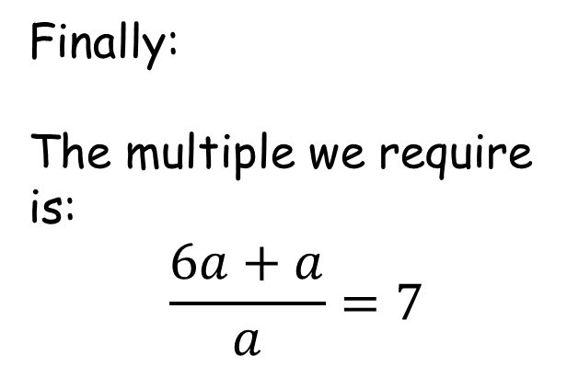
Triangle Multiple
Finally:
The multiple we require is:
$$\frac{6a+a}{a}=7$$
$$4$$
$$6a$$
$$3$$
$$a$$
$$8$$
$$4$$

Slide 9
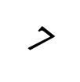
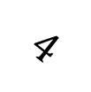
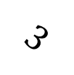
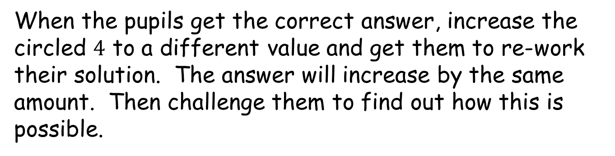
Note to Teacher - 1
Each answer is obtained by adding the two numbers circled.
$$4$$
$$3$$
$$7$$
$$8$$
$$4$$
When the pupils get the correct answer, increase the circled $4$ to a different value and get them to re-work their solution. The answer will increase by the same amount. Then challenge them to find out how this is possible.

Slide 10




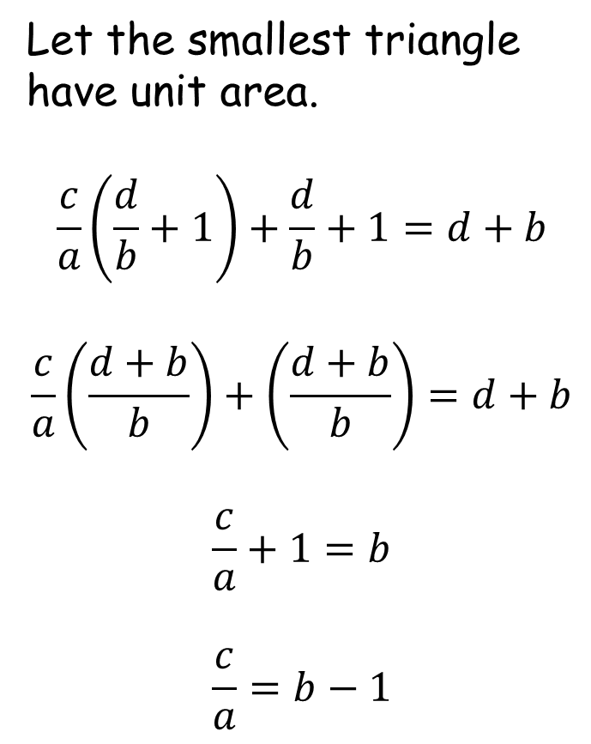



Note to Teacher - 2
Let the smallest triangle have unit area.
$$\frac{c}{a}\left(\frac{d}{b}+1\right)+\frac{d}{b}+1=d+b$$
$$\frac{c}{a}\left(\frac{d+b}{b}\right)+\left(\frac{d+b}{b}\right)=d+b$$
$$\frac{c}{a}+1=b$$
$$\frac{c}{a}=b−1$$
$$d$$
$$\frac{d}{b}$$
$$\frac{c}{a}\left(\frac{d}{b}+1\right)$$
$$b$$
$$1$$
$$c$$
$$a$$
On every worksheet the equation to the right applies.

Slide 11


Note to Teacher - 3
$$4$$
$$3$$
$$a$$
$$8$$
$$4$$
You can use the GeoGebra file to show that the angle, $a$, has no bearing on the solution by moving the blue dot.

Slide 13
RESOURCES

Slide 14




SIC_66
Triangle Multiple
$$4$$
(Not to scale)
$$3$$
$$8$$
$$4$$
In terms of area, what multiple of the smaller triangle is the larger triangle?

Slide 15




SIC_66
Triangle Multiple
$$5$$
(Not to scale)
$$4$$
$$9$$
$$3$$
In terms of area, what multiple of the smaller triangle is the larger triangle?

Slide 16




SIC_66
Triangle Multiple
$$6$$
(Not to scale)
$$5$$
$$8$$
$$2$$
In terms of area, what multiple of the smaller triangle is the larger triangle?

Slide 17



SIC_66
Triangle Multiple
$$7$$
(Not to scale)
$$6$$
$$10$$
$$2$$
In terms of area, what multiple of the smaller triangle is the larger triangle?

Slide 18
SIC_66
Triangle Multiple
$$7$$
(Not to scale)
$$3$$
$$8$$
$$4$$
In terms of area, what multiple of the smaller triangle is the larger triangle?

Slide 19
SIC_66
Triangle Multiple
$$7$$
(Not to scale)
$$4$$
$$9$$
$$3$$
In terms of area, what multiple of the smaller triangle is the larger triangle?

Slide 20
SIC_66
Triangle Multiple
$$7$$
(Not to scale)
$$5$$
$$8$$
$$2$$
In terms of area, what multiple of the smaller triangle is the larger triangle?

Slide 21

SIC_66
Triangle Multiple
$$9$$
(Not to scale)
$$6$$
$$10$$
$$2$$
In terms of area, what multiple of the smaller triangle is the larger triangle?

Slide 22



SIC_66
Triangle Multiple
$$8$$
(Not to scale)
$$3$$
$$12$$
$$6$$
In terms of area, what multiple of the smaller triangle is the larger triangle?

Slide 23

SIC_66
Triangle Multiple
$$9$$
(Not to scale)
$$4$$
$$6$$
$$2$$
In terms of area, what multiple of the smaller triangle is the larger triangle?

Slide 24



SIC_66
Triangle Multiple
$$11$$
(Not to scale)
$$5$$
$$4$$
$$1$$
In terms of area, what multiple of the smaller triangle is the larger triangle?

Slide 25

SIC_66
Triangle Multiple
$$11$$
(Not to scale)
$$6$$
$$5$$
$$1$$
In terms of area, what multiple of the smaller triangle is the larger triangle?

Slide 26


SIC_66
Triangle Multiple
$$14$$
(Not to scale)
$$7$$
$$12$$
$$2$$
In terms of area, what multiple of the smaller triangle is the larger triangle?

Slide 27


SIC_66
Triangle Multiple
$$9$$
(Not to scale)
$$8$$
$$14$$
$$2$$
In terms of area, what multiple of the smaller triangle is the larger triangle?

Slide 28
SIC_66
Triangle Multiple
$$11$$
(Not to scale)
$$5$$
$$4$$
$$1$$
In terms of area, what multiple of the smaller triangle is the larger triangle?

Slide 29
SIC_66
Triangle Multiple
$$11$$
(Not to scale)
$$6$$
$$5$$
$$1$$
In terms of area, what multiple of the smaller triangle is the larger triangle?

Slide 30
SIC_66
Triangle Multiple
$$5$$
(Not to scale)
$$3$$
$$8$$
$$4$$
In terms of area, what multiple of the smaller triangle is the larger triangle?

Slide 31

SIC_66
Triangle Multiple
$$13$$
(Not to scale)
$$4$$
$$9$$
$$3$$
In terms of area, what multiple of the smaller triangle is the larger triangle?

Slide 32
SIC_66
Triangle Multiple
$$13$$
(Not to scale)
$$5$$
$$8$$
$$2$$
In terms of area, what multiple of the smaller triangle is the larger triangle?

Slide 33
SIC_66
Triangle Multiple
$$11$$
(Not to scale)
$$6$$
$$10$$
$$2$$
In terms of area, what multiple of the smaller triangle is the larger triangle?

Slide 34
SIC_66
Triangle Multiple
$$8$$
(Not to scale)
$$3$$
$$8$$
$$4$$
In terms of area, what multiple of the smaller triangle is the larger triangle?

Slide 35
SIC_66
Triangle Multiple
$$7$$
(Not to scale)
$$4$$
$$9$$
$$3$$
In terms of area, what multiple of the smaller triangle is the larger triangle?

Slide 36


SIC_66
Triangle Multiple
$$20$$
(Not to scale)
$$7$$
$$24$$
$$4$$
In terms of area, what multiple of the smaller triangle is the larger triangle?

Slide 37


SIC_66
Triangle Multiple
$$21$$
(Not to scale)
$$8$$
$$21$$
$$3$$
In terms of area, what multiple of the smaller triangle is the larger triangle?

